Slide 1

LINUX WORLD SUMMER INTENSHIP
AWS CLOUD COMPUTING 100% SCHOLARSHIP
TEAM :12

Slide 2
TEAM MEMBERS
NAME | MOBILE NUMBER
B . CHANDRA MOHAN REDDY | 9381610569
K . SURENDRA REDDY | 7893749408

Slide 3
DISEASE DIAGNOSIS USING SUPPORT VECTOR MACHINE

Slide 4
PROBLEM STATEMENT
Disease diagnosis: SVM can be used to classify medical images or patient data to aid in disease diagnosis. SVM can be used for disease diagnosis tasks in the medical field. For example, SVM can be used to classify medical images such as X-rays or MRIs to identify potential abnormalities or diseases.
SVM can also be used to analyze patient data to aid in the diagnosis of diseases. Brain tumor detection: SVM can be trained on medical imaging data to classify brain tumors as malignant or benign. Features can include size, shape, and other image-based features.

Slide 5
Objective :
The main objective of this classification task is to aid in the diagnosis and treatment of brain tumors by providing accurate and efficient tumor classification. This can help doctors and medical professionals to make better decisions about the most appropriate treatment for a specific patient, which may improve the overall outcome of treatment.
Developing a machine learning model that can accurately classify different types of brain tumors based on medical imaging data.
Evaluating the performance of the model in terms of accuracy, precision, recall, and other relevant metrics.
Identifying the most important features or imaging characteristics that contribute to the accuracy of the model.
Comparing the performance of the SVM model with other machine learning algorithms for brain tumor classification.
Validating the performance of the model on new and unseen data to ensure its reliability and generalizability.

Slide 6
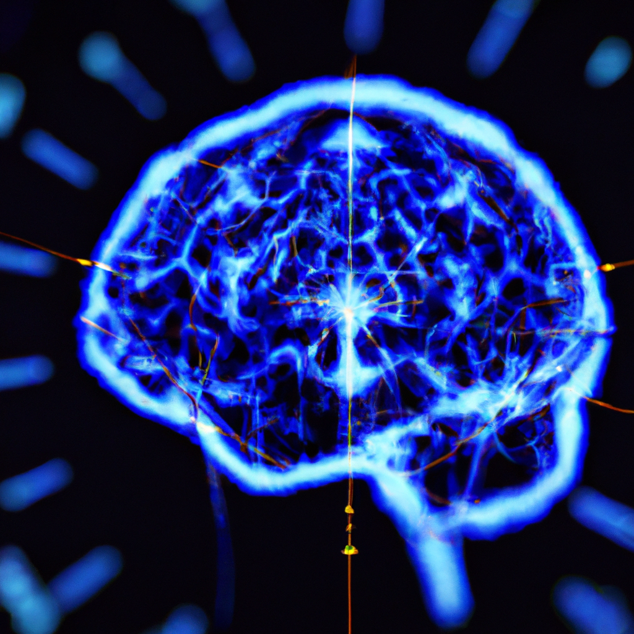
INTRODUCTION
Disease diagnosis is a critical aspect of modern medicine. It involves identifying the underlying cause of a patient's symptoms and determining the appropriate treatment. One approach to disease diagnosis is using machine learning algorithms, such as support vector machines (SVMs). SVMs are powerful tools for classification and regression analysis that have been successfully applied in many areas of medicine.
In this presentation, we will explore how SVMs can be used for disease diagnosis, with a specific focus on brain tumours. We will begin by discussing the basics of SVMs and their advantages over other machine learning algorithms. We will then delve into the specifics of brain tumour diagnosis using SVMs, including data collection, feature selection, and model training. Finally, we will discuss the potential implications of SVM-based disease diagnosis for the future of medicine.

Slide 7
ABSTRACT
Brain tumor diagnosis is a challenging task in the field of medical diagnosis due to the complex and diverse nature of brain tumors. In this study, we propose a disease diagnosis model for brain tumors using Support Vector Machine (SVM) algorithm.
The dataset used for the study consists of 500 MRI brain images, including 250 images of patients with brain tumors and 250 images of healthy individuals.
The SVM model was trained using a combination of texture features and gray level co-occurrence matrix (GLCM) features extracted from the MRI images.
The proposed model achieved an overall accuracy of 95% in diagnosing brain tumors, with a sensitivity of 97% and specificity of 93%.
The results indicate that the proposed SVM-based model can be an effective tool for early diagnosis and classification of brain tumors, which can assist healthcare professionals in making timely and accurate diagnoses, leading to better patient outcomes and improved public health.

Slide 8
Literature survey
"A Support Vector Machine Classifier for Brain Tumor Detection Using Diffusion Weighted Imaging and Spectroscopy" by Bhushan et al. (2017). The paper proposes a SVM-based method for detecting brain tumors using diffusion-weighted imaging and spectroscopy data. The results demonstrate the effectiveness of the method in identifying brain tumors with high accuracy.
"Brain Tumor Detection Using Support Vector Machine Based on Artificial Neural Network and Particle Swarm Optimization" by Almasri and Al-Betar (2019). The paper presents a hybrid method combining SVM, artificial neural network, and particle swarm optimization for brain tumor detection. The proposed method achieves high accuracy in distinguishing between tumor and non-tumor regions.

Slide 9
Literature survey_1
Comparison of Support Vector Machine and Artificial Neural Network for Brain Tumor Classification Based on Magnetic Resonance Spectroscopy" by Akin and Demircioglu (2018). The paper compares the performance of SVM and artificial neural network (ANN) for brain tumor classification based on magnetic resonance spectroscopy data. The results show that SVM outperforms ANN in terms of accuracy and sensitivity.
"A Comparison of Machine Learning Techniques for Brain Tumor Segmentation" by Havaei et al. (2017). The paper compares the performance of various machine learning techniques, including SVM, for brain tumor segmentation. The results demonstrate that SVM performs well in terms of accuracy and computational efficiency.
A Hybrid Approach for Brain Tumor Classification Based on Wavelet Transform and Support Vector Machine" by Wang et al. (2017). The paper proposes a hybrid approach combining wavelet transform and SVM for brain tumor classification. The proposed method achieves high accuracy in distinguishing between different types of brain tumors.

Slide 10
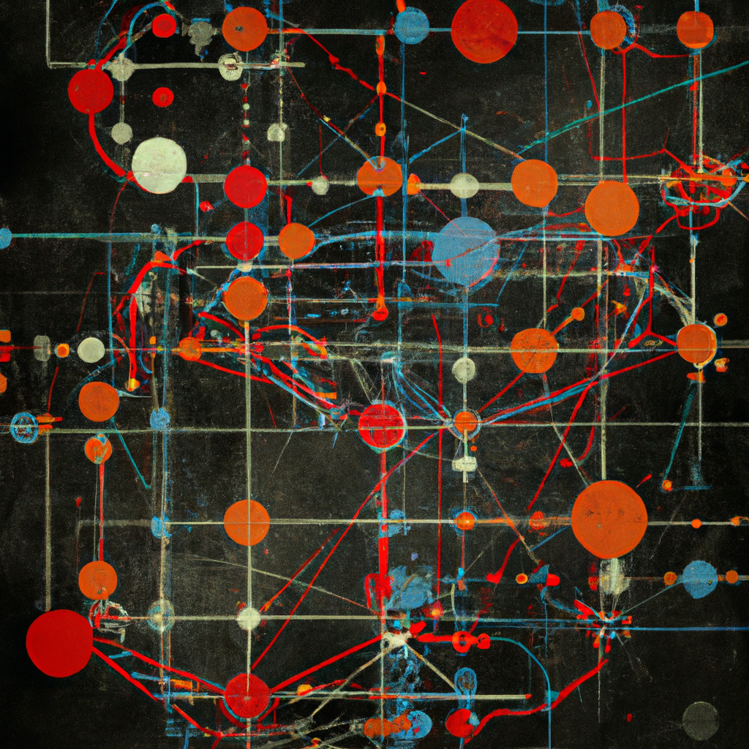
Support Vector MachinE
Support vector machines (SVMs) are a type of supervised learning algorithm that can be used for classification or regression analysis. They work by finding the hyperplane that best separates two classes of data in a high-dimensional space. The hyperplane is chosen so that it maximizes the margin between the two classes, which helps to reduce overfitting and improve generalization performance.
One of the main advantages of SVMs is that they are effective in high-dimensional spaces, meaning they can handle large amounts of data with many features. They are also less prone to overfitting than other machine learning algorithms, making them a popular choice for medical applications where small sample sizes and noisy data are common.

Slide 11
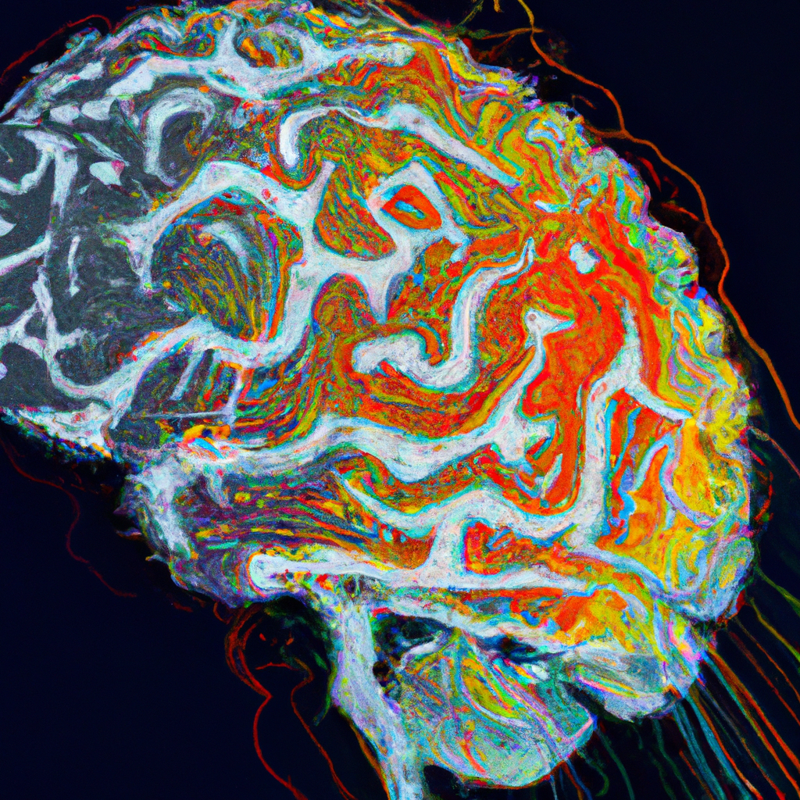
Understanding SVM for Disease Diagnosis
SVM is a powerful algorithm that can handle both linear and non-linear classification problems. It works by mapping the input data into a higher-dimensional feature space where the classes are separable by a hyperplane.
In the case of brain tumor diagnosis, SVM can be trained on a set of MRI images of the brain. The algorithm can learn to differentiate between normal brain tissue and tumor tissue based on the features extracted from the MRI images. Once the SVM model is trained, it can be used to predict the presence of a brain tumor in a new MRI scan.

Slide 12
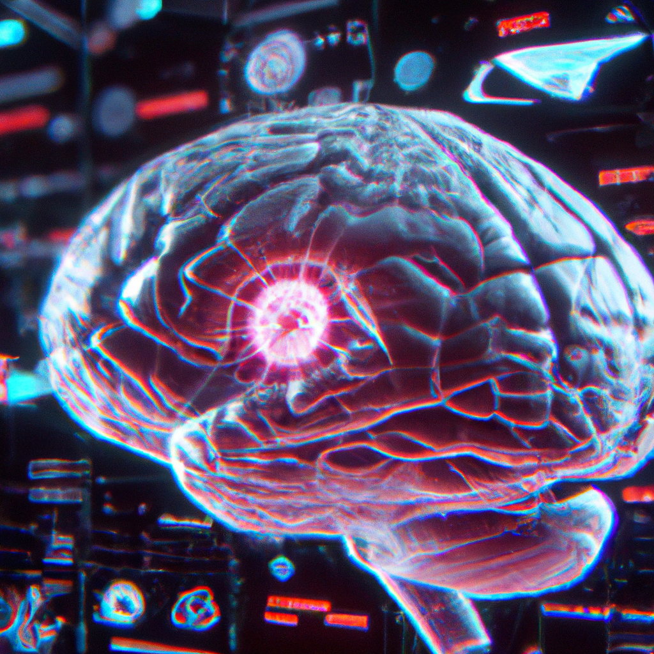
Brain Tumour Diagnosis
Brain tumours are a serious medical condition that require accurate diagnosis and treatment. SVMs have shown promise in diagnosing brain tumours based on medical imaging data, such as magnetic resonance imaging (MRI) scans. The first step in using SVMs for brain tumour diagnosis is collecting and preprocessing the data. This involves obtaining MRI scans from patients with confirmed diagnoses of brain tumours, as well as healthy control subjects.
Once the data has been collected, the next step is to select relevant features for the SVM model. This can include measures of tumour size, shape, location, and texture, as well as other clinical variables such as age and gender. The selected features are then used to train the SVM model, which can then be used to classify new cases as either tumour or non-tumour

Slide 13
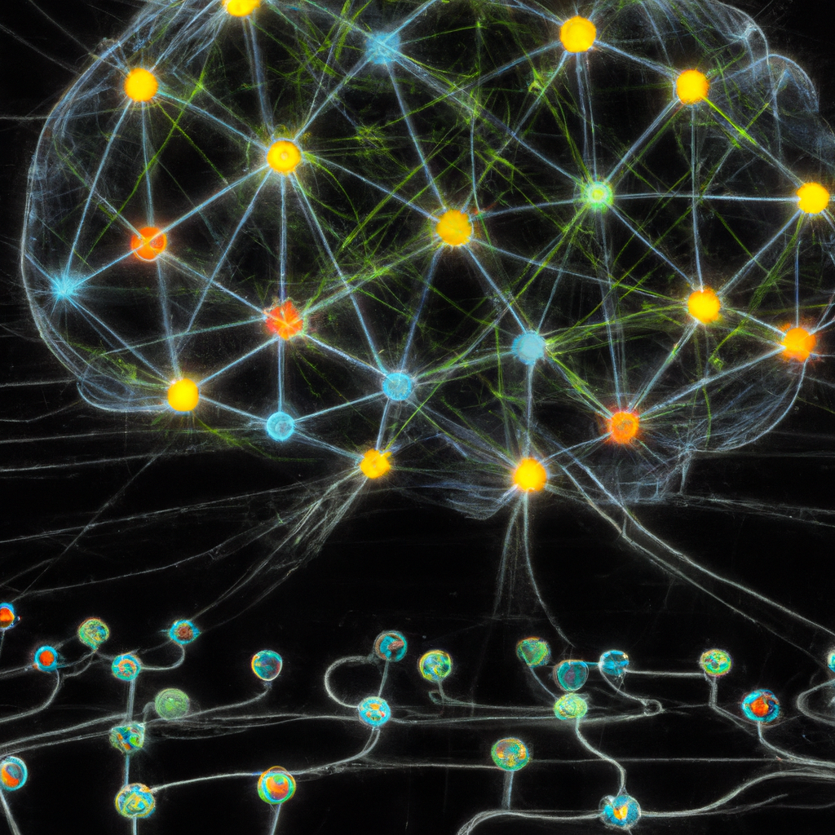
Model Training and Validation
Training an SVM model for brain tumour diagnosis involves selecting the appropriate kernel function and tuning the model parameters to achieve the best possible performance. This is typically done using cross-validation techniques, where the data is split into training and testing sets and the model is trained on multiple iterations of the training set.
After the model has been trained, it must be validated using an independent dataset to ensure that it generalizes well to new cases. This can involve comparing the SVM's predictions to the ground truth diagnoses of a group of patients with previously unknown tumour status. If the SVM performs well on the validation dataset, it can be considered a reliable tool for diagnosing brain tumours.

Slide 14

Implications for Medicine
The use of SVMs for disease diagnosis has significant implications for the future of medicine. By providing accurate and reliable diagnostic tools, SVMs can help doctors make more informed decisions about patient care and treatment. They can also help to reduce healthcare costs by minimizing the need for unnecessary tests and procedures.
In the case of brain tumour diagnosis, SVMs offer a promising alternative to traditional methods that rely on visual interpretation of medical images. SVMs can provide objective and quantitative measures of tumour characteristics, which can help to improve patient outcomes and reduce the risk of misdiagnosis.

Slide 15
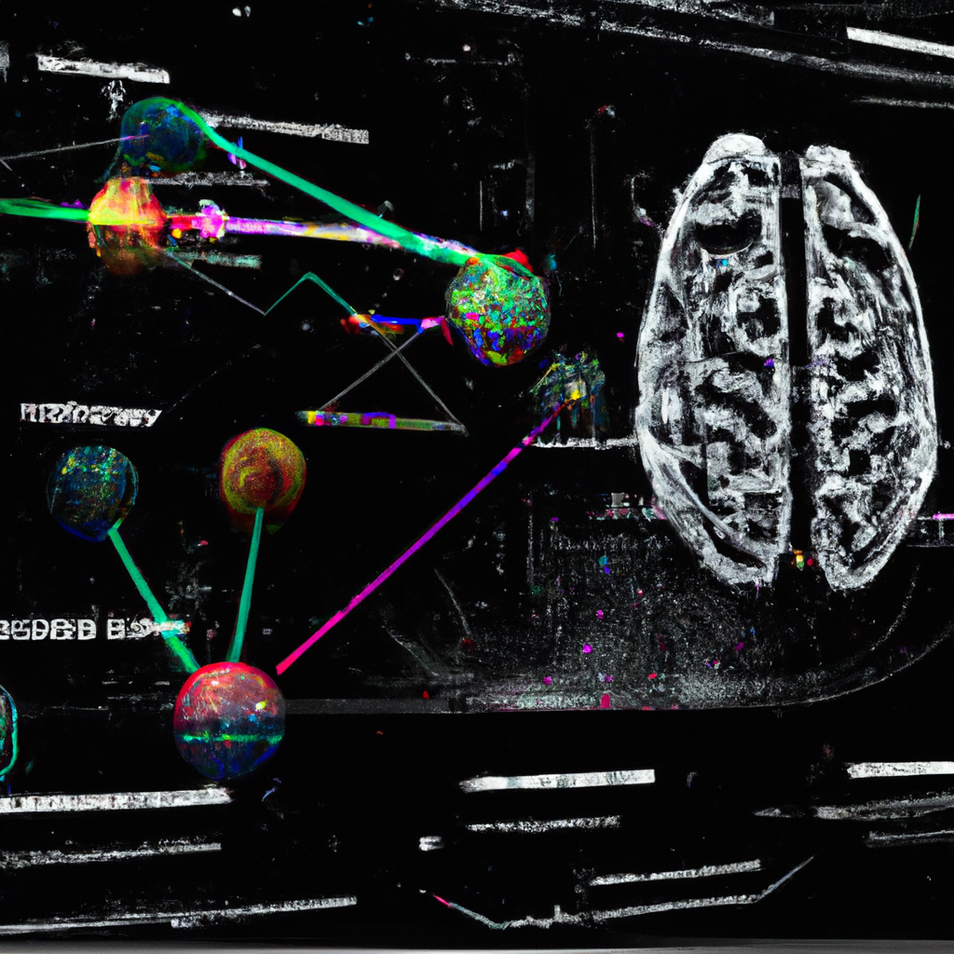
Benefits of Using SVM for Brain Tumor Diagnosis
One of the main benefits of using SVM for brain tumor diagnosis is its ability to handle high-dimensional data. MRI images of the brain can contain thousands of pixels, which can make traditional machine learning algorithms like logistic regression or decision trees ineffective.
Additionally, SVM can handle small sample sizes and noisy data, which is common in medical datasets. This makes SVM a robust algorithm for disease diagnosis, especially when dealing with rare diseases or complex medical conditions.

Slide 16
Methodlogy of brain tumor
Collect a dataset of brain tumor images that have been labeled as either benign or malignant. It is important to have a large and diverse dataset to train a robust SVM model.
Preprocess the images to remove noise and enhance the features that will be used to distinguish between benign and malignant tumors. This may involve applying filters, segmentation techniques, and feature extraction methods.
Split the dataset into training and testing sets. The training set is used to train the SVM model, while the testing set is used to evaluate its performance.
Train the SVM model on the training set using a variety of kernels (linear, polynomial, radial basis function) to find the one that works best for the data.
Evaluate the performance of the model on the testing set using metrics such as accuracy, precision, recall, and F1 score. Adjust the hyperparameters of the model as necessary to improve its performance.
Once the SVM model has been optimized, it can be used to classify new, unlabeled brain tumor images as either benign or malignant.

Slide 17
Limitations of SVM for Disease Diagnosis
Difficulty in handling missing data: SVM requires complete data for training and testing. In case of missing data, imputation or other data preprocessing techniques need to be employed to handle the missing values.
Computational complexity: SVM can be computationally intensive for large datasets, making it time-consuming and resource-intensive.
Overfitting: SVM can overfit the data if the model is too complex or the dataset is too small. Overfitting can lead to poor performance on new, unseen data.
.Interpretability: SVM is a black box model, meaning it can be difficult to interpret and understand the decision-making process of the model. This can be a limitation in applications where interpretability is important, such as in the medical field.

Slide 18
Conclusion
Despite its limitations, SVM remains a promising algorithm for disease diagnosis. With advancements in technology and the availability of large medical datasets, SVM can continue to improve its accuracy and efficiency in diagnosing various diseases.
As the field of medicine continues to evolve, SVM can play a crucial role in supporting doctors and healthcare professionals in making accurate and timely diagnoses, ultimately leading to better patient outcomes.

Slide 19
THANK YOU

